Slide 1
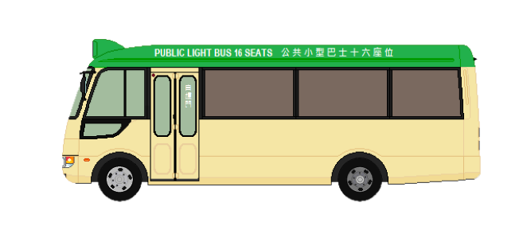
Smart- Mini_Bus App

Slide 2

Why Tourist Need It
Help Tourist visit HK easier

Slide 3
The function of Smart - Mini_Bus App
Target customer: Tourists
know which mini_bus can take
Search different Route
Trace the mini_bus(GPS)
provide currency exchange rate
Alight Alarm function
translation

Slide 4
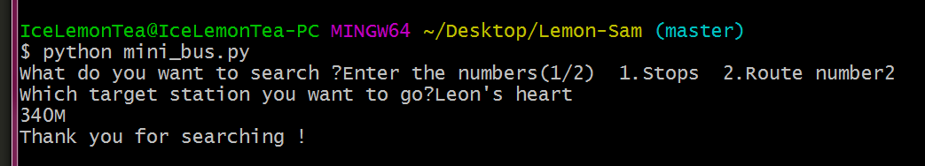
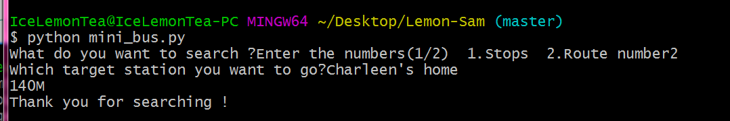
Demonstration
Checking suitable Route number

Slide 5
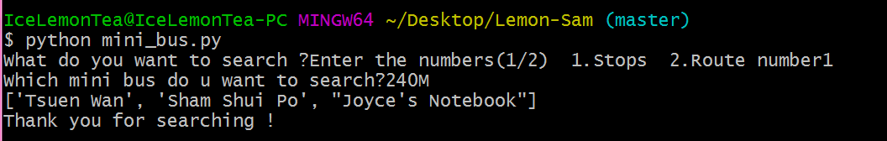
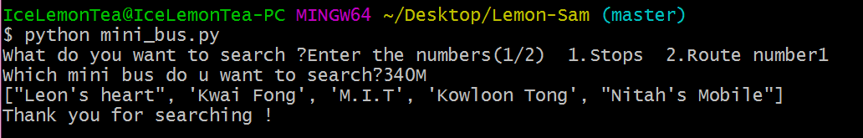
Demonstration
Checking the Stops

Slide 6
THANKS!

